Slide 1
IBM University Engagement Project Submission
“Exploring the Power of Agentic AI with IBM Granite and LangFlow”

Slide 2
Project Tile – RAG Agent for DIP Diet
Domain of Project –Healthcare
Faculty Name | Email ID | Mobile number [WhatsApp]
Samreen Mohammed Basit Shaikh | qazisamreen15@gmail.com | 8055672952

Slide 3
Problem Statement - RAG Agent for DIP Diet
The Challenge
Health-conscious individuals and nutritionists often struggle with scattered diet plans, food charts, and wellness guidelines. The DIP Diet (Disciplined & Intelligent Plan) approach emphasizes natural foods and lifestyle discipline, but its resources—books, blogs, and expert advice—are fragmented and hard to personalize. The challenge is not just to retrieve diet information but to synthesize, personalize, and provide actionable dietary recommendations.
The Objective
Build a Vector Store RAG (Retrieval-Augmented Generation) Agent that serves as an intelligent diet assistant for DIP followers. The solution should:
Ingest & Index DIP Resources: Collect diet plans, nutrition guides, and related health documents, and store them in a vector database for semantic search.
Enable Conversational Q&A: Allow users to ask natural questions (e.g., “What can I eat for breakfast in the DIP diet?”) and get clear, personalized responses.
Create a Personalized & Agentic Layer: Adapt diet suggestions based on user profile, lifestyle, medical conditions, or fitness goals while recommending food substitutions.
Visualize Diet Guidance: Provide a clean dashboard with daily/weekly meal plans, nutrition breakdown, and lifestyle tips to help users stay disciplined with DIP.
Tech Stack (Mandatory)
IBM Langflow / IBM Orchestrate + IBM Models

Slide 4
Proposed Solution -
Proposed Solution: DIP Smart Nutrition Assistant
A Vector Store RAG Agent built using IBM Langflow, IBM Orchestrate and IBM Granite Models.
• Ingests DIP diet books, blogs, meal plans and nutrition guides.
• Creates embeddings and stores them in a Vector Database (FAISS/Chroma).
• Retrieves relevant diet knowledge using RAG.
• Generates personalized meal recommendations based on age, lifestyle, health conditions and fitness goals.
• Provides food substitutions and wellness tips.
• Supports conversational Q&A and multilingual interaction.
• Dashboard visualizes daily meal plans, nutrition breakdown and progress tracking.

Slide 5

Role of Agentic AI in the solution
Role of Agentic AI in the Solution
Agentic AI enables autonomous decision making and collaboration among specialized agents.
• Nutrition Knowledge Agent retrieves verified DIP information.
• Diet Planner Agent generates personalized meal plans.
• Food Substitute Agent recommends alternatives.
• Wellness Coach Agent provides hydration, sleep and activity guidance.
• Agents continuously adapt recommendations using user feedback and goals.
The result is a proactive digital nutrition assistant instead of a static chatbot.

Slide 6
Technology Used
IBM Cloud – It provides the infrastructure to build, deploy, and scale the Nutrition Agent efficiently. IBM Cloud enables a reliable, secure, and scalable environment for deploying the Nutrition Agent.
RAG– RAG to fetch real data first, then generate intelligent answers, making the Nutrition Agent more trustworthy and effective.
IBM Watsonx.ai - For model deployment, embeddings, and AI governance

Slide 7
DIP Diet RAG Knowledge Base
DIP Diet Principles
Recommended Foods
Foods to Avoid
Disease-Specific Guidance
Food Substitutions
Lifestyle Recommendations
Sample User Queries

Slide 8
Novelty and Uniqueness
• DIP-specific RAG knowledge base
• Multi-Agent Architecture
• Personalized recommendations using profile data
• Food substitution intelligence
• Nutrition and wellness dashboard
• Multilingual support
• Explainable and trustworthy responses using RAG
• Enterprise-ready deployment on IBM ecosystem

Slide 9
Github Link
https://github.com/sam15-hub/RAG-Agent-for-DIP-Diet.git

Slide 10
BEHAVIOR OF THE SYSTEM
The RAG Agent for DIP Diet acts as an intelligent digital nutrition assistant that retrieves, analyzes, and personalizes dietary recommendations based on DIP (Disciplined & Intelligent Plan) principles.
User Interaction • The user enters a query such as:
"What can I eat for breakfast?"
"Suggest a diet plan for diabetes."
"Give an alternative to sprouts." • The system accepts user profile information including age, weight, health conditions, dietary preferences, and fitness goals.
Knowledge Retrieval • The query is converted into embeddings. • The system searches the vector database containing DIP diet resources. • Relevant diet information is retrieved using semantic search.
Context Understanding • IBM Granite analyzes both the retrieved information and the user's profile. • The system understands the user's nutritional requirements and health objectives.
Personalized Recommendation • The Diet Planning Agent generates customized meal plans. • The Food Substitution Agent suggests alternatives when a food item is unavailable or disliked. • The Wellness Coach Agent provides hydration, exercise, and lifestyle recommendations.

Slide 11
Response Generation • Watson Orchestrate coordinates all agents. • IBM Granite generates a clear, accurate, and personalized response. • Responses are based on retrieved knowledge rather than generic AI-generated content.
Dashboard Updates • Daily meal plans are displayed. • Nutritional information such as calories, protein, carbohydrates, fiber, and fat is shown. • Weekly progress and health recommendations are updated.
Continuous Adaptation • The system adapts recommendations according to user feedback and changing goals. • New diet documents can be added to the knowledge base without retraining the model.
Expected Behavior: • Accurate retrieval of DIP diet knowledge. • Personalized dietary recommendations. • Context-aware responses. • Healthy food substitution suggestions. • Lifestyle and wellness guidance. • Interactive conversational experience. • Reliable and scalable nutrition assistance using IBM Watson Orchestrate and Granite Models.

Slide 12
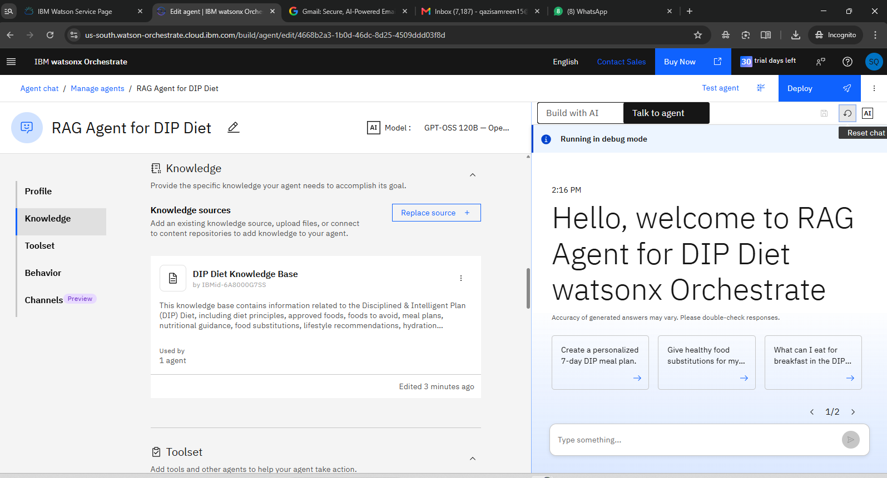

Slide 13
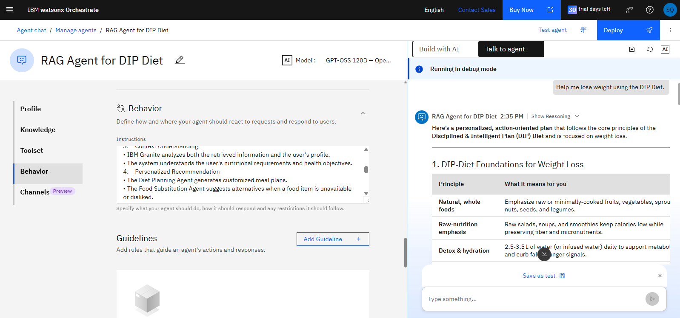

Slide 14
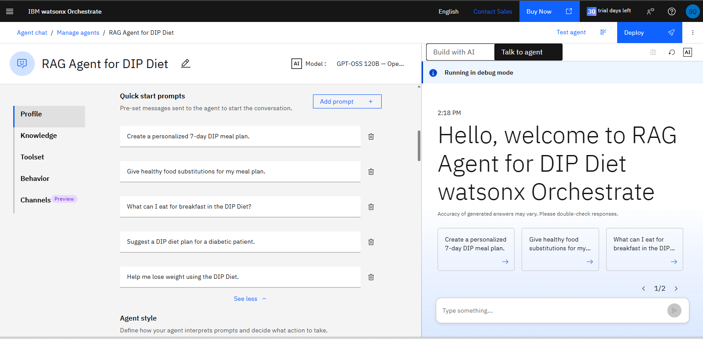

Slide 15
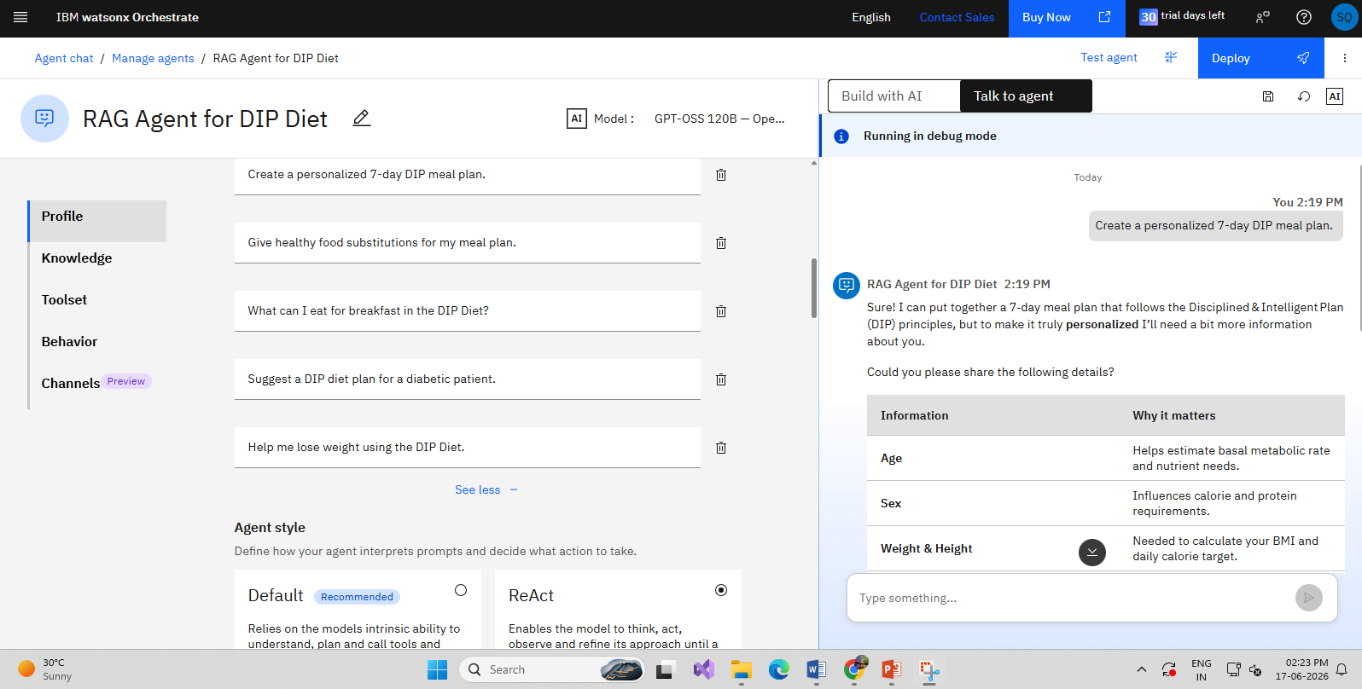

Slide 16
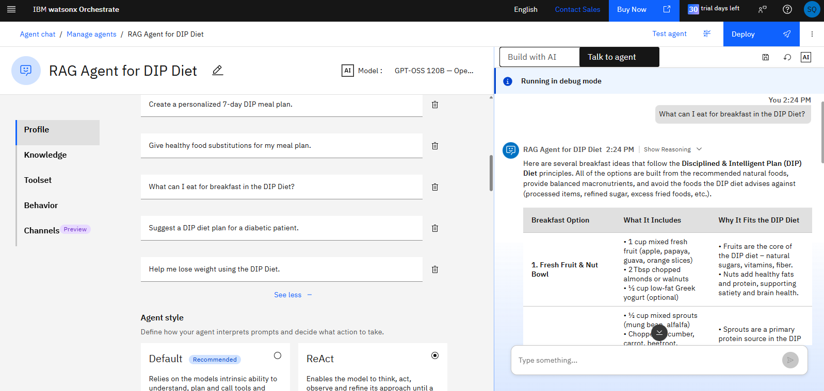

Slide 17
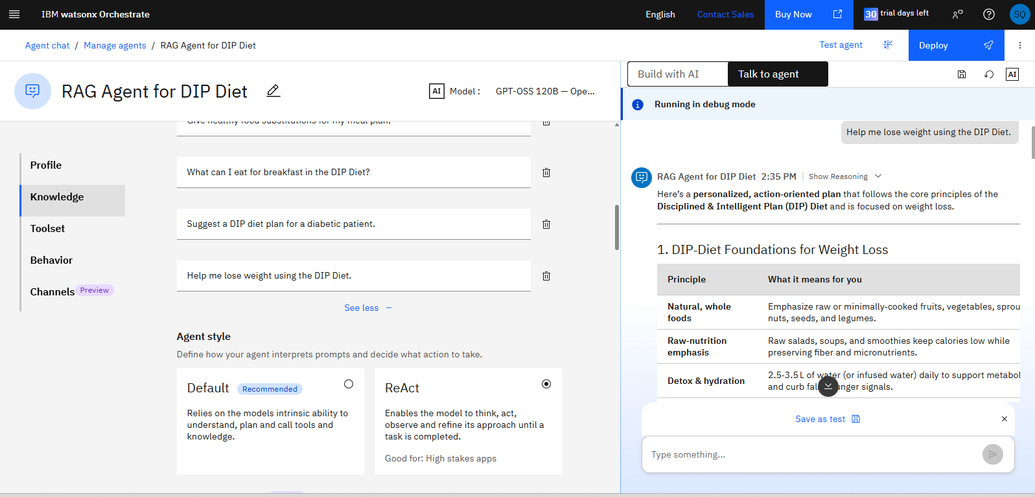

Slide 18
Future Scope
Wearable Integration – Connect with smartwatches and fitness trackers for real-time health monitoring.
Voice & Multilingual Support – Enable voice interaction and support multiple languages.
Image-Based Food Recognition – Identify food items from images and provide nutritional analysis.
Personalized Disease Management – Offer specialized diet plans for diabetes, hypertension, obesity, and heart conditions.
Smart Grocery Planning – Automatically generate grocery lists based on meal plans.
Mobile Application – Develop Android and iOS apps for meal tracking and reminders.
Predictive Health Analytics – Use AI to predict nutritional deficiencies and health risks.
Healthcare Integration – Connect with nutritionists, hospitals, and telemedicine platforms.
Future Vision:
Transform the DIP Diet RAG Agent into a comprehensive AI-powered digital nutrition
coach that provides personalized, proactive, and real-time wellness guidance.
·
·
·

Slide 19
Thank You!

